Slide 1

The Data Extractors
Design Document
Mason Lanham
Austin Meredith
Luis Carrillo
Chris Mendoza
David Garcia

Slide 2
Design Document Breakdown
Upper Level Design - Class diagram showing the presentation logic of the software that should interface with the Lower Design.
Lower level Design - class diagram showing the logic of the data we’ll be extracting and saving in the XML file
Dataflow - a diagram that shows how the presentation logic and data logic work together, and data movement within them.
Flowchart - Sequence diagram showing the presentation logic.
XML Schema Design - A description of the structure and components of the XML schema we’ll be using.

Slide 3
Upper Level Design
VariableUtility
OutputFileLocation : String[1] OutputFileName : String[1] InputFilePath : String[1]
OutputCheckValidity() : Boolean InputCheckValidity() : Boolean EndProgram() : Void
Help
HelpList : String[*]
HelpDisplay(Integer) : String
Parser/Labeler
XMLStrings : String[1…*]
ParseLabelFile(String) : Boolean SaveXML() : Boolean
Interpreter
CommandList : String[*]
InterpretCommand(String) : Boolean CheckCommandValidity() : Boolean

Slide 4
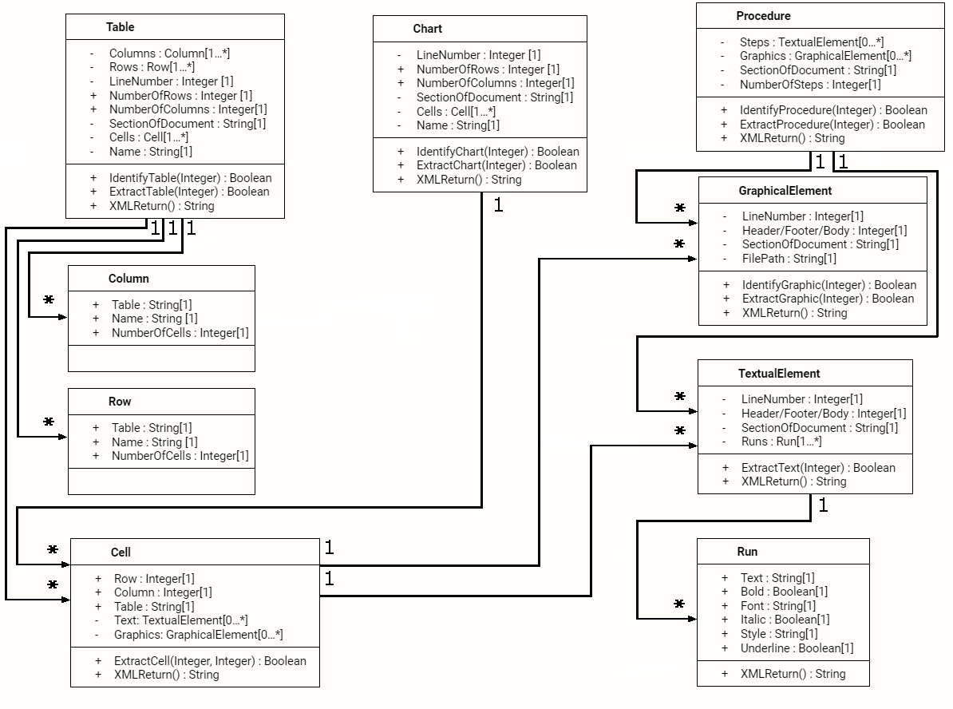
Lower Level Design

Slide 5
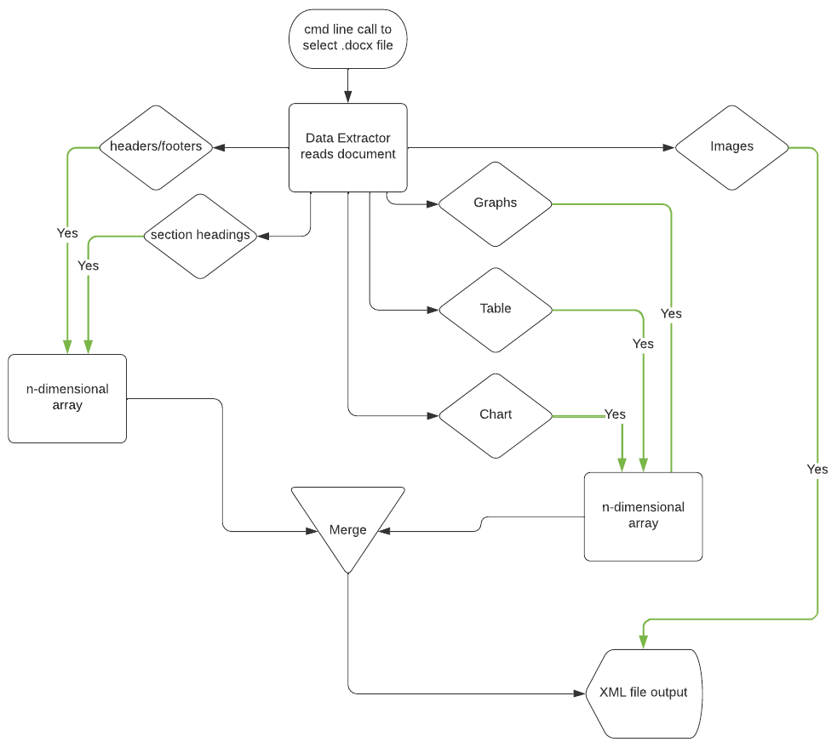
Dataflow

Slide 6
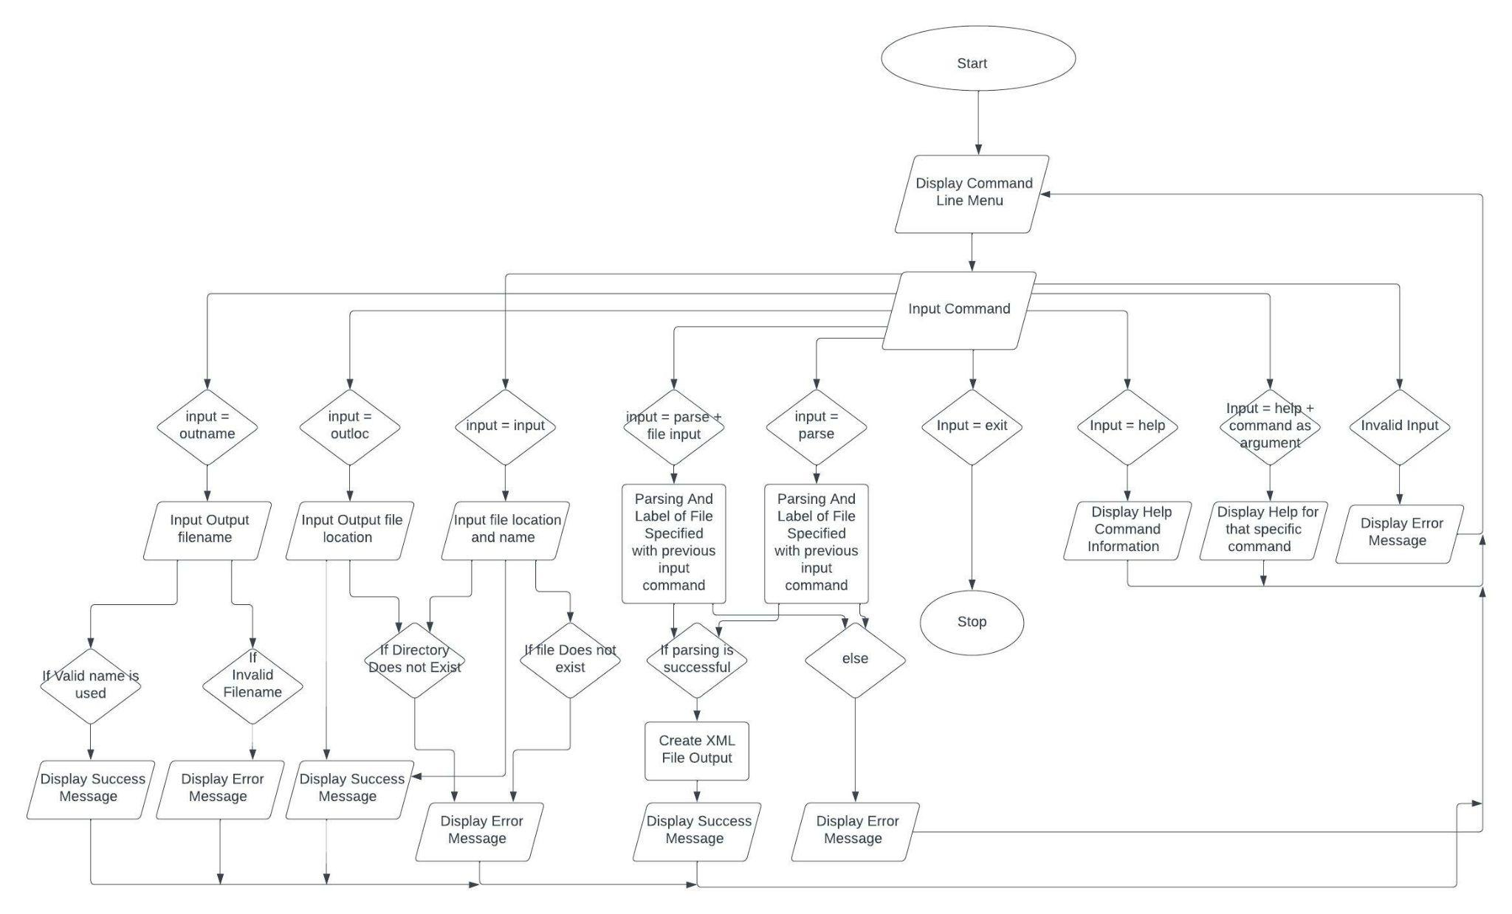
Flowchart

Slide 7
XML Schema Design
We’ll need to define XML elements in order to properly display the data from a Word document in our output XML file
Examples of an element in a XML schema:
<Employee>
<Name>John Smith</Name>
<Salary>75000</Salary>
<IDNum>12345</IDNum>
</Employee>
The types of XML elements we’ll need:
Text Output Related Elements
Text (String)
Font (String)
Style (String)
Bold (Boolean)
Italics (Boolean)
Underline (Boolean)
Procedures/Lists Related Elements
Steps (String)
Graphics (String reference to filepath)
NumOfSteps (Integer) SectionOfDocument (String)
Graphics Related Elements
LineNumber (Integer)
Header/Footer/Body(Integer),
SectionOfDocument (String)
FilePath (String)
Tables & Chart Related Elements
Name/Label (String),
SectionOfDocument(String)
Location(Int),
Rows, Columns, Cells
NumColumns, NumRows (Int)

Slide 8

Version Control
We chose to use GitHub as our version control system. We’ll be using the GitHub repository located at the URL https://github.com/AustinFoxtrot/Word-Data-Extractor for this project.

